Slide 1
shopBLT Discussion Presentation
Phillip Nguyen
Matthew Morales
Jason Tam
Juwan Michael De Jesus
Alonso De La Torre Vega

Slide 2
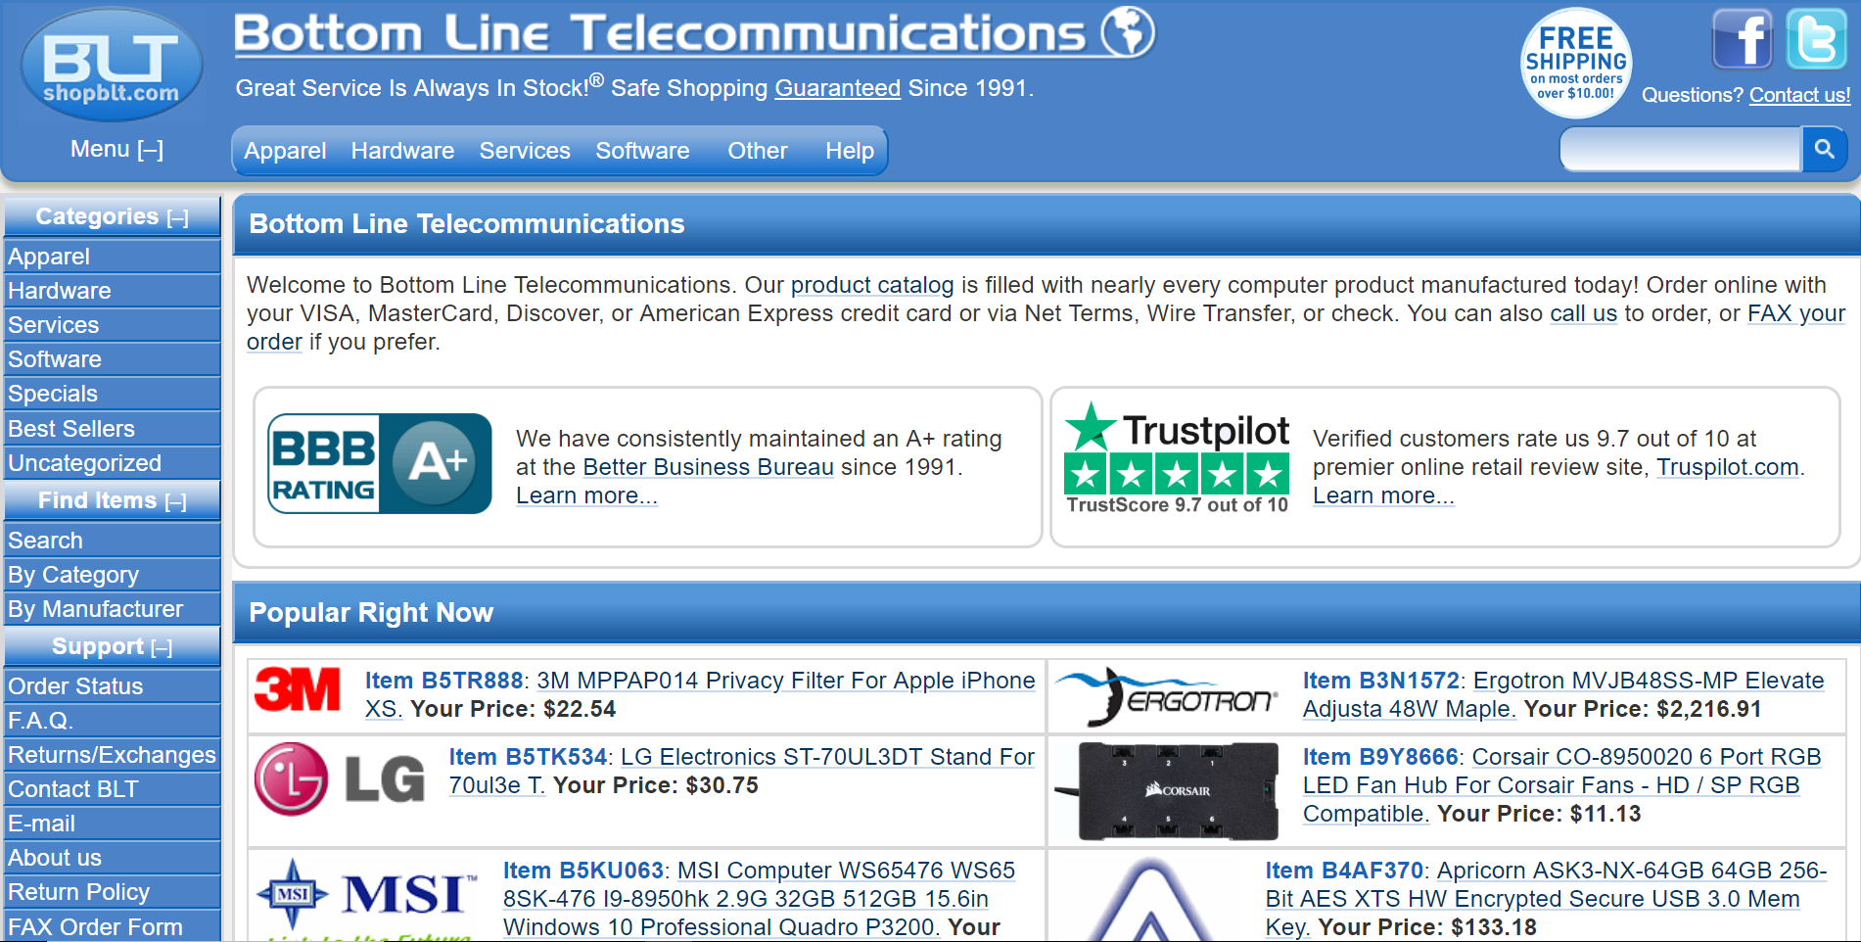
About shopBLT
Founded 1991
Evolved from systems design and consulting firm (now e-commerce)
Providing over 300,00 items from major manufacturers
Software, licensing, consumer electronics, wireless solutions
Claims unparalleled service in industry
Domestic and international
Niche marketplace (high domain knowledge)

Slide 3
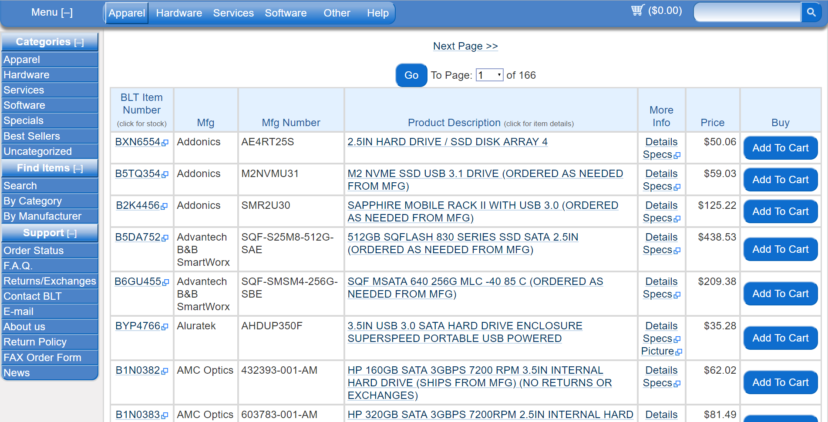
Why shopBLT?
Legacy System
Built before and maintained throughout UX/UI era
Difficult product discovery
Binary search system
Unfriendly to inexperienced users

Slide 4
Beneficial changes we want to implement
Align technology to reach wider customer base
Improve usability among inexperienced users
Improve product discovery
Reduce backtracking
Product visibility
Increase availability of product information
Images

Slide 5
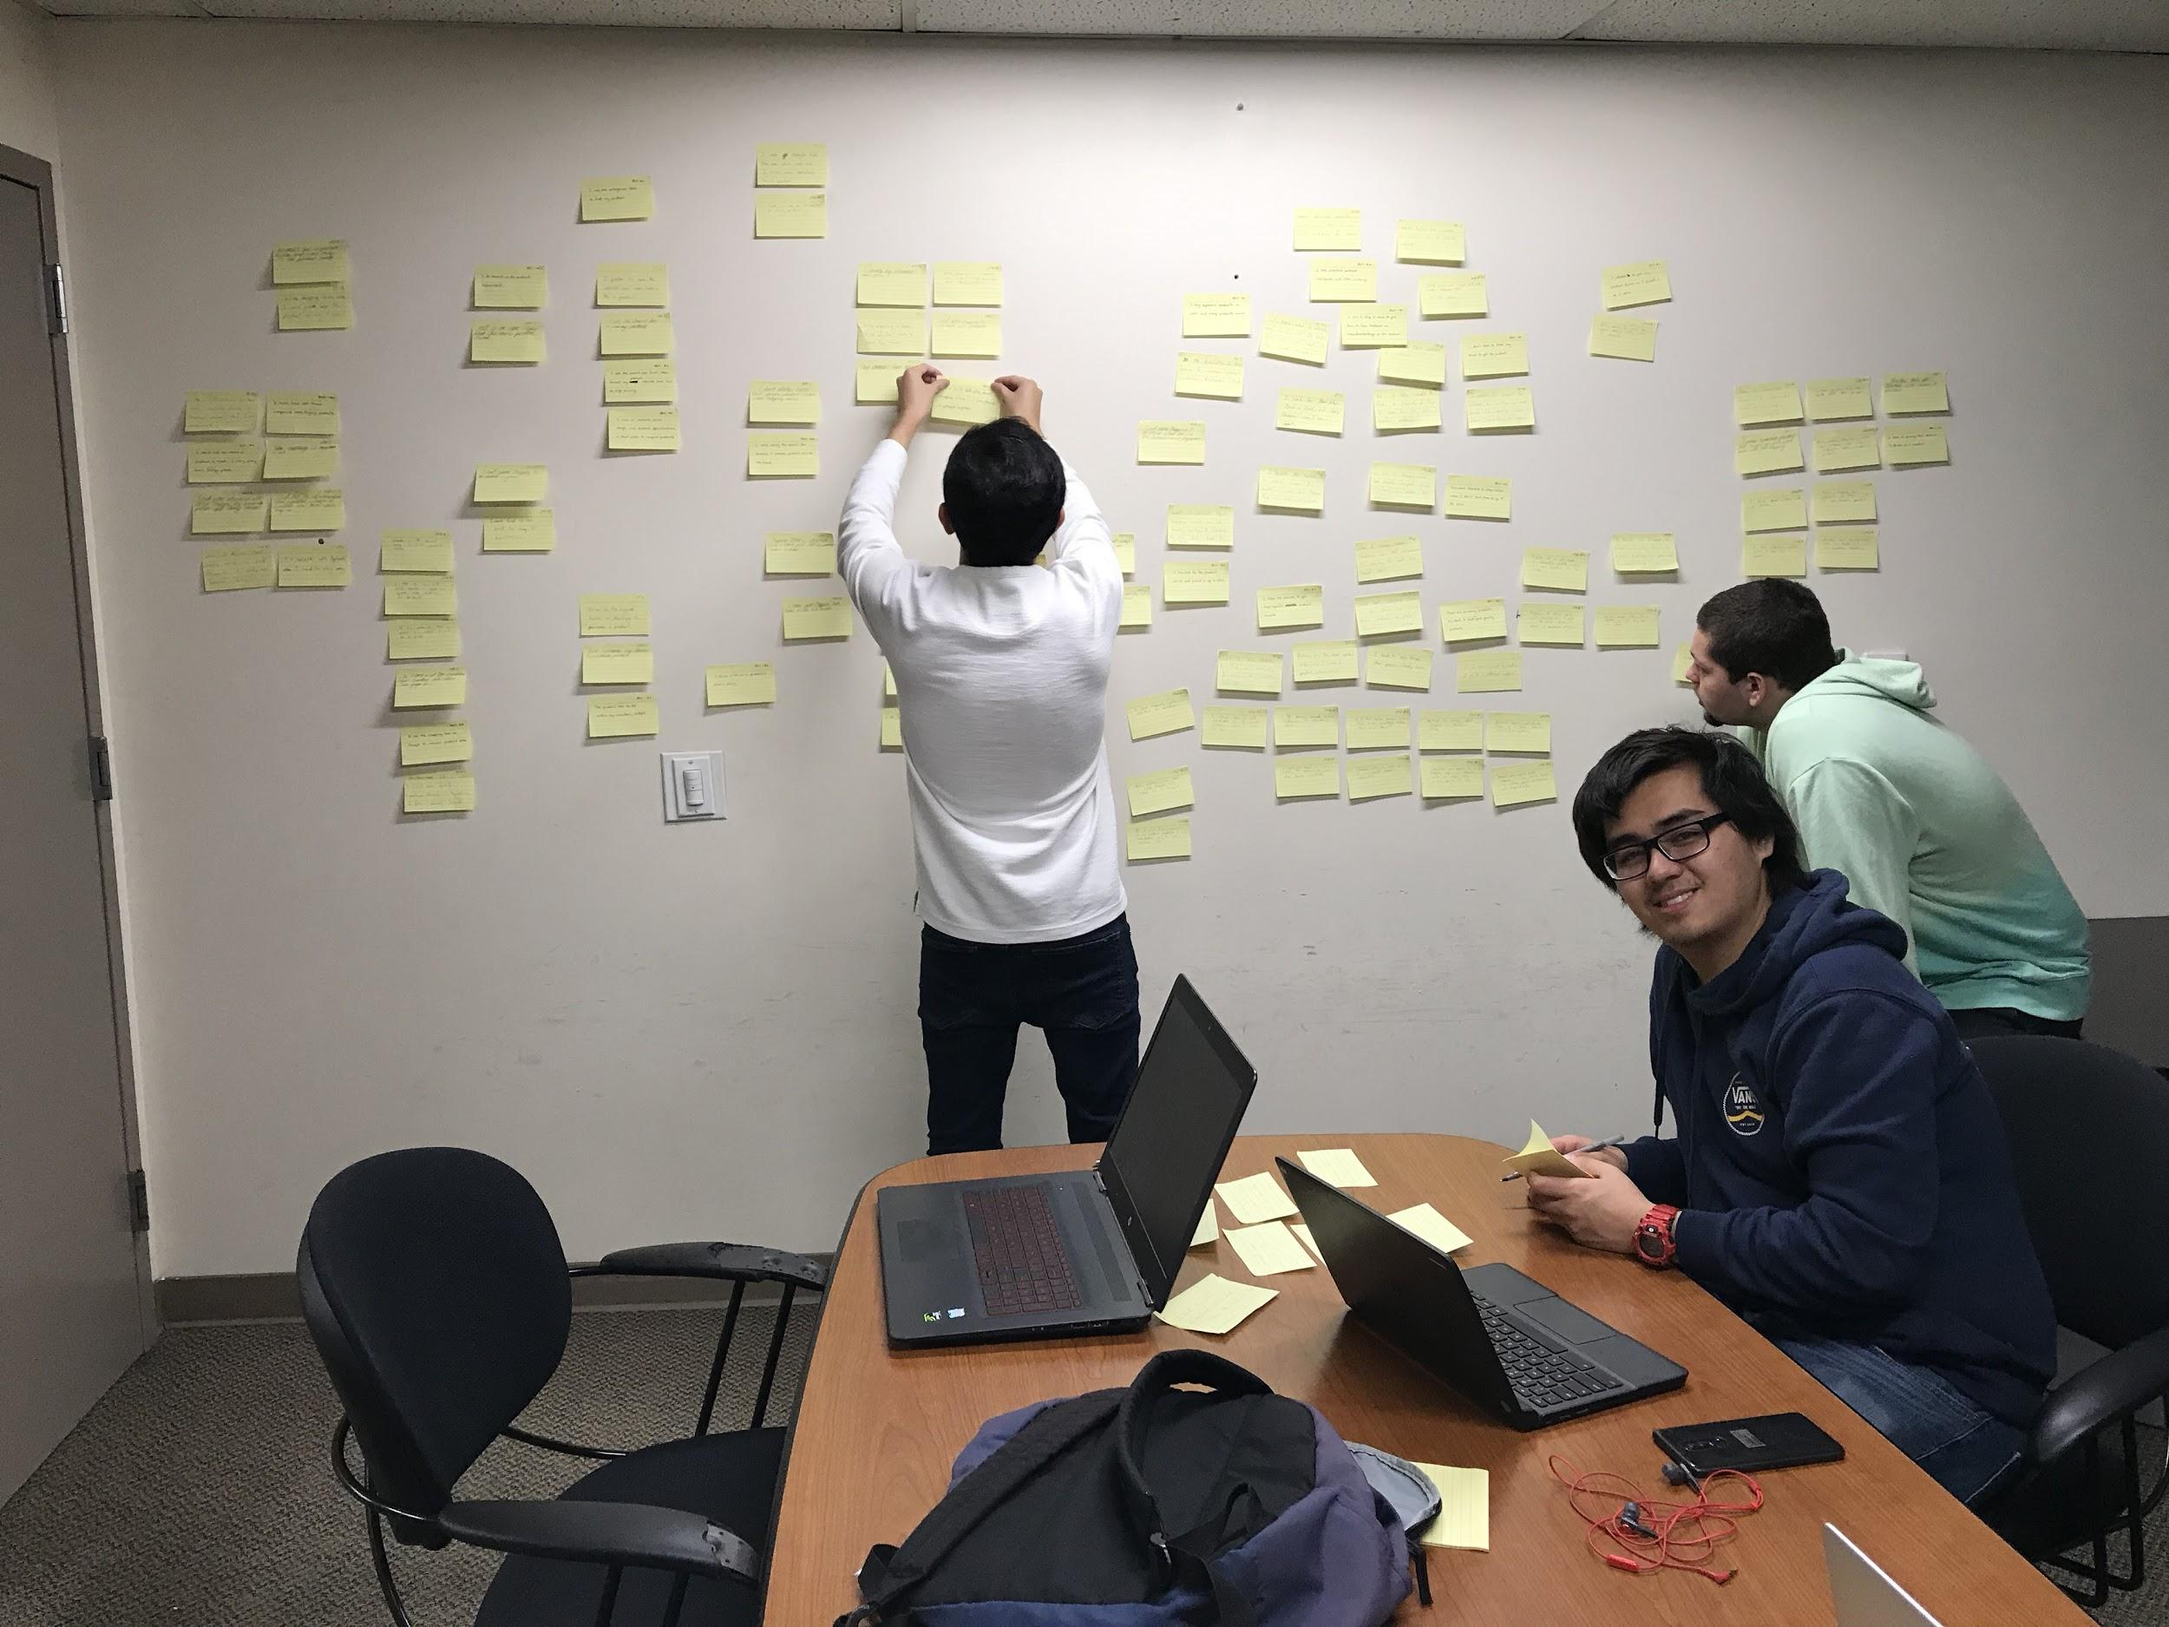
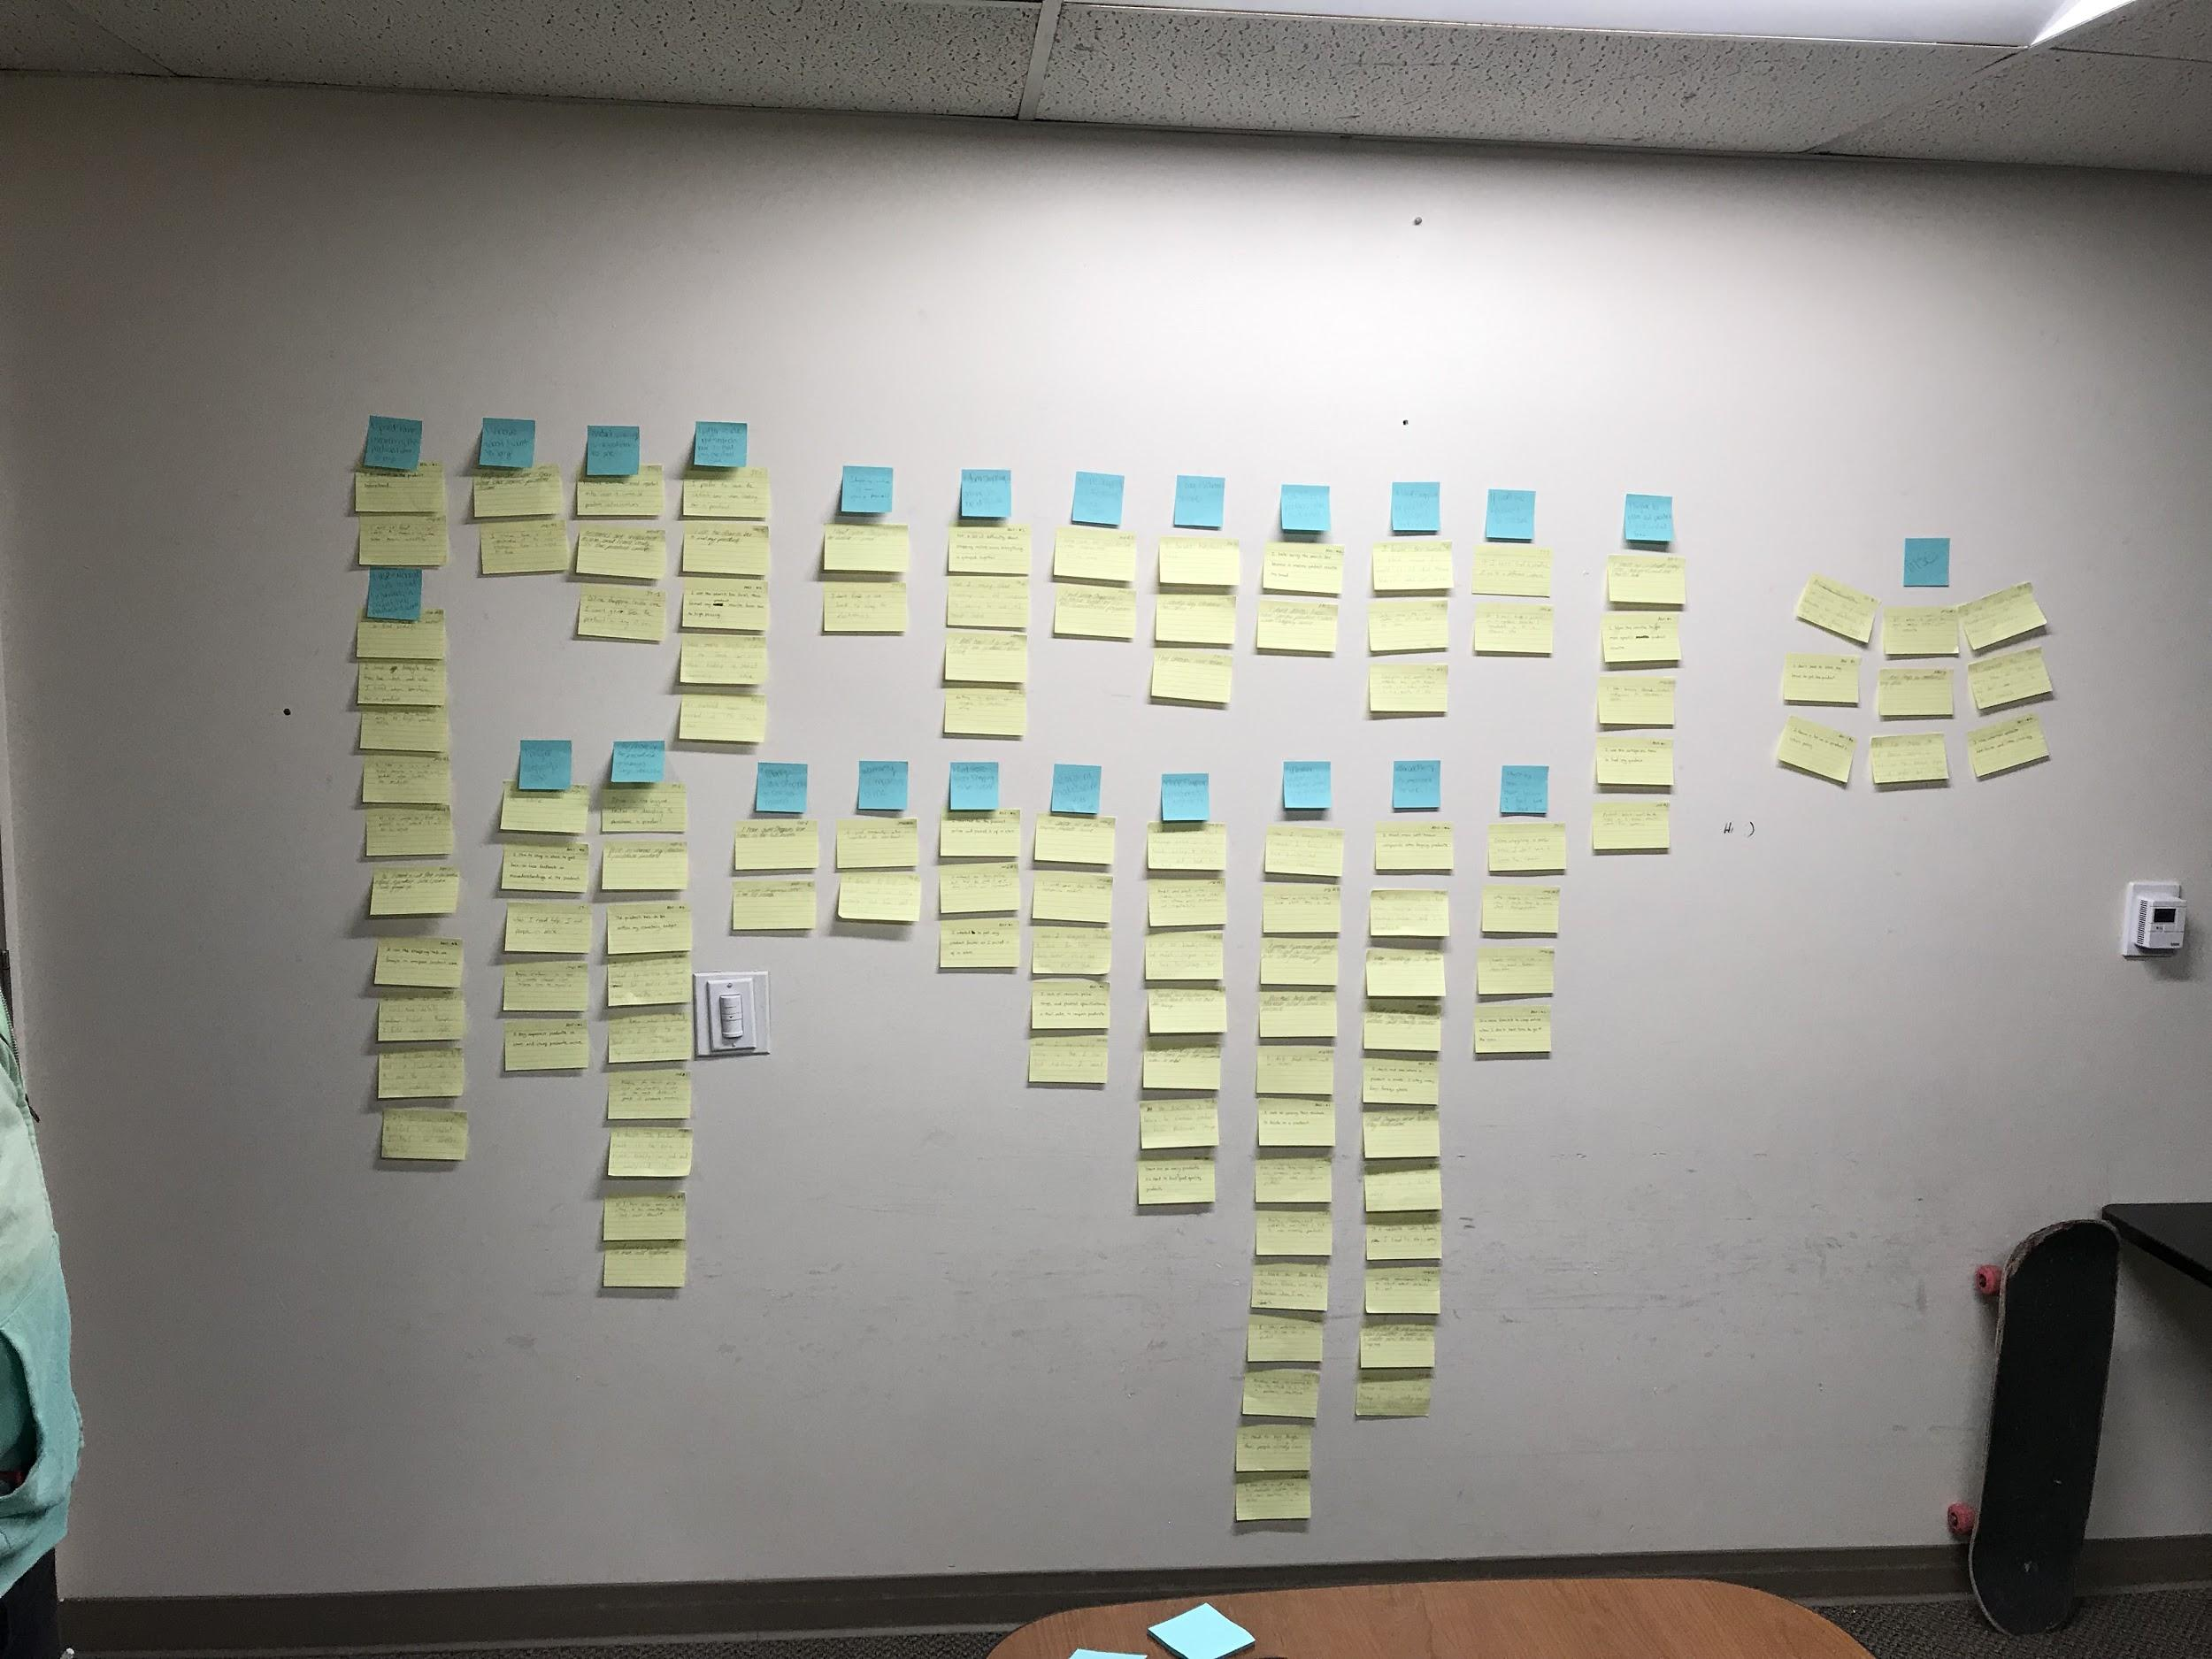
What we’ve done
Our Goals:
Understand how customers select and order electronics
Discover pain points, and pleasures, within search patterns for electronic products online
Discover what customers do to seek information about electronics online
Discover preferences for browsing within electronic categories
Understand what product information is valuable to customers when they are searching for electronics
Methods:
Surveys
Interviews
Affinity Diagram

Slide 6
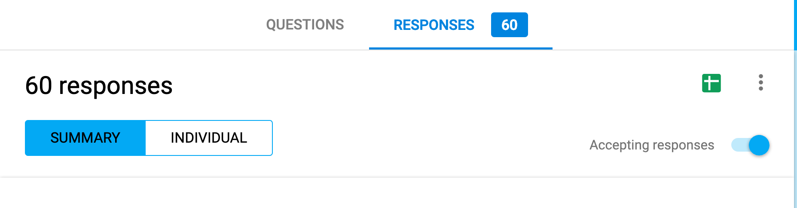
Research Findings
Consumers value product visibility (images)
Preference for in-store shopping for electronics
Knowledge deficiencies
High use of external information sources
Google, YouTube, Reddit
> 50% of sometimes have difficulty finding products

Slide 7
What we’re going to do
Usability testing
Created 5 usability tasks…(so far)
Will try to target our preferred system audience
If not, just in general is fine

Slide 8
Thank You!
Any questions?

